Slide 1
Marketing and Sales Audit- Braceloc

Slide 2
Summary
Marketing Presentation
Technical Introduction
Technical Solutions
Planning
Conclusion

Slide 3
Presentation
Real-time location tracking, sharing
GPS position exchange
Emergency communication
No network coverage dependency
skin sensor integration
Objective: Enable offline location tracking and distress alerting for friends, family, and group members while ensuring privacy with a skin sensor integration.

Slide 4
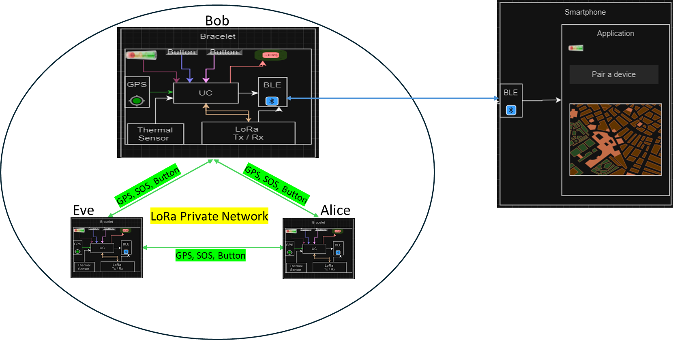
Marketing presentation: Usage scenario

Slide 5
Technical introduction
State of the art :
Location of group members
Drones | Traditional methods
Satellites | Applications

Slide 6
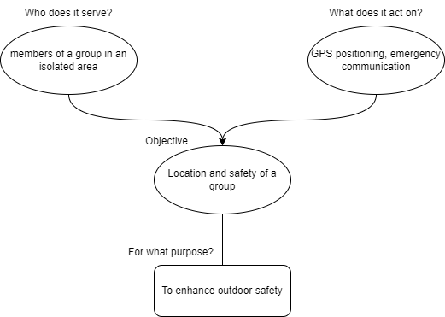
Technical introduction
Functional Analysis

Slide 7
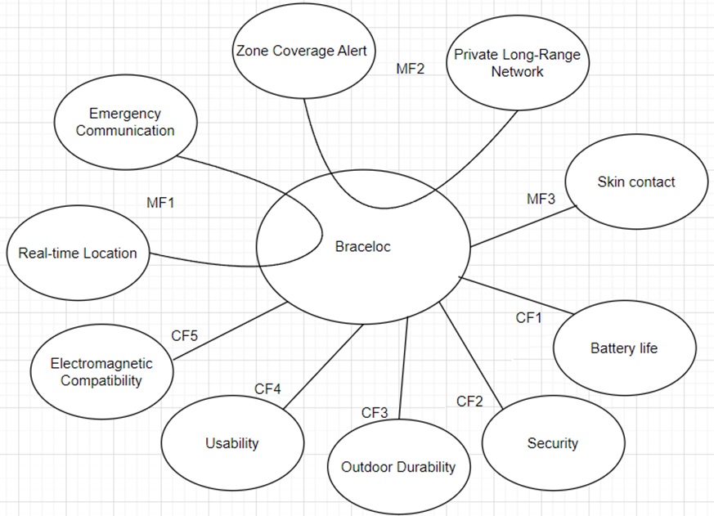
Technical introduction
Functional Analysis

Slide 8
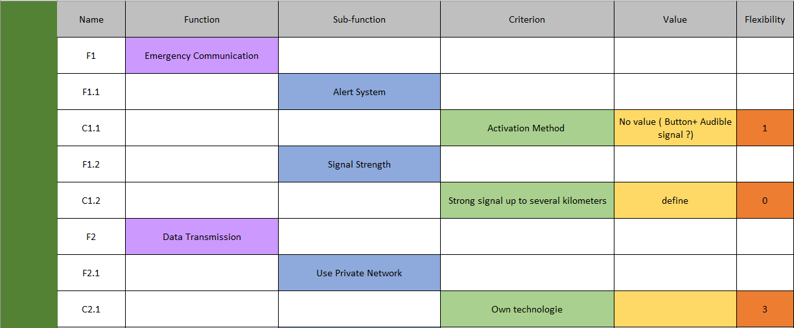
Technical introduction

Slide 9
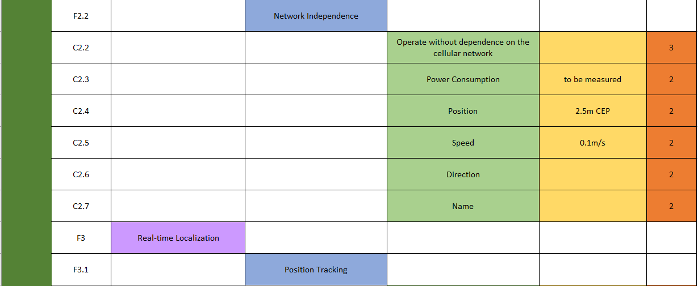
Technical introduction

Slide 10
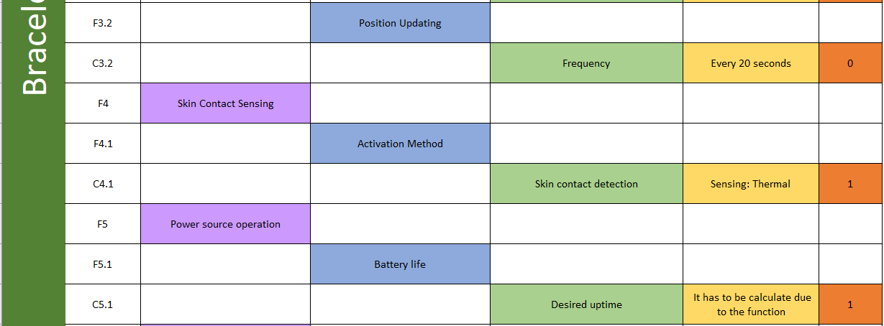
Technical introduction

Slide 11
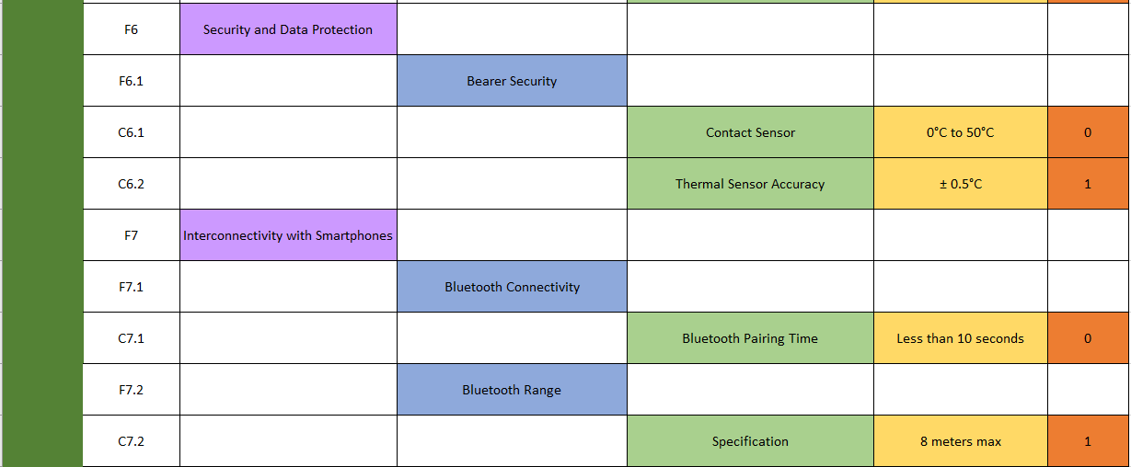
Technical introduction

Slide 12
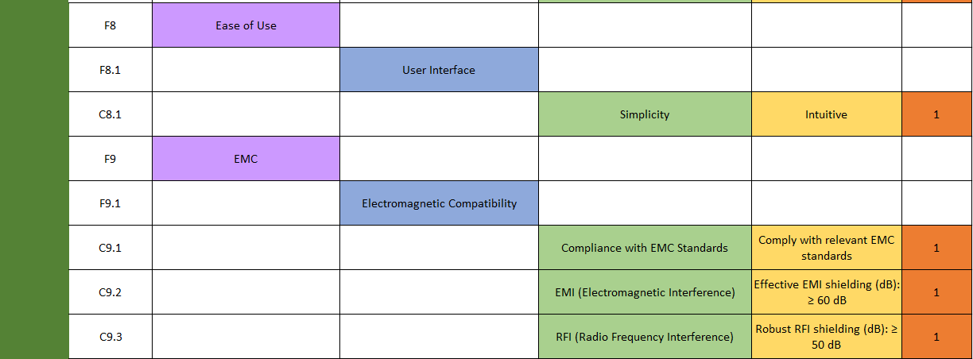
Technical introduction

Slide 13
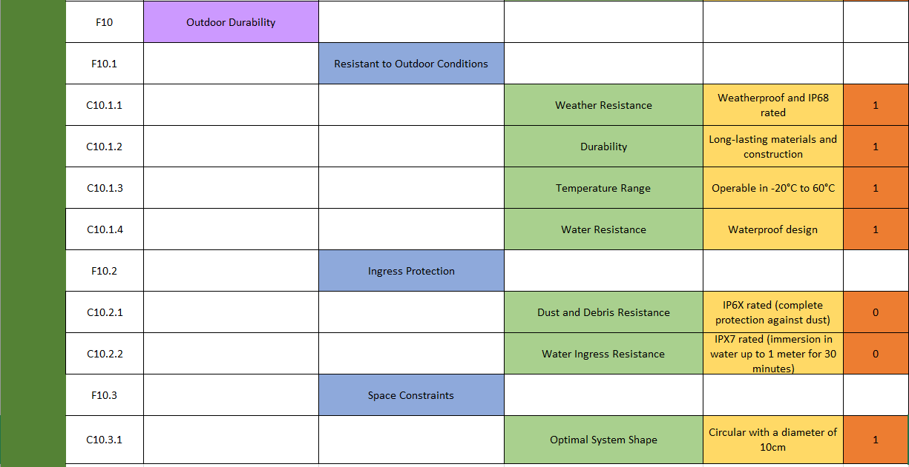
Technical introduction

Slide 14
Key partners
Electronics and GPS Component Manufacturer
Wireless Communication Technology Provider
Manufacturing and Assembly Supplier
Mobile App Developers
Distributors and Retailers
Logistics Partners
Security and Data Protection Experts
Marketing and Communication Partners

Slide 15
Key ressources
LoRa Network
LoRaWan security
Humans (hikers, explorers)
GPS module
Bluetooth Low Energy (BLE) module
Thermal Sensor
Software Solution
Banks

Slide 16
Key activities
Product Development :
Manufacturing
Software Development
Marketing and Promotion
Distribution
Customer Support
Security Measures
Distribution Channels:
Retail Stores
Online Platforms
Direct Sales
Partnerships
Customer Relationship:
Pre-Sales Support
Onboarding
Training and Education
Customer Support
Community Engagement

Slide 17
Revenue stream
Braceloc Sales: Revenue from selling Braceloc bracelets.
Subscription Services: Income from subscription plans offering enhanced features.
Partnership Collaborations: Revenue generated through partnerships with retailers or event organizers.
Data Insights: Income from providing anonymized user data insights.
Technology Licensing: Revenue from licensing Braceloc technology.

Slide 18
Value Propositions
Geolocate your group in real time
Knowing the direction and the speed of each member of the group
Send a distress signal in case of emergency
Send a gathering message to group's members
Access to each person's position reserved for group members

Slide 19
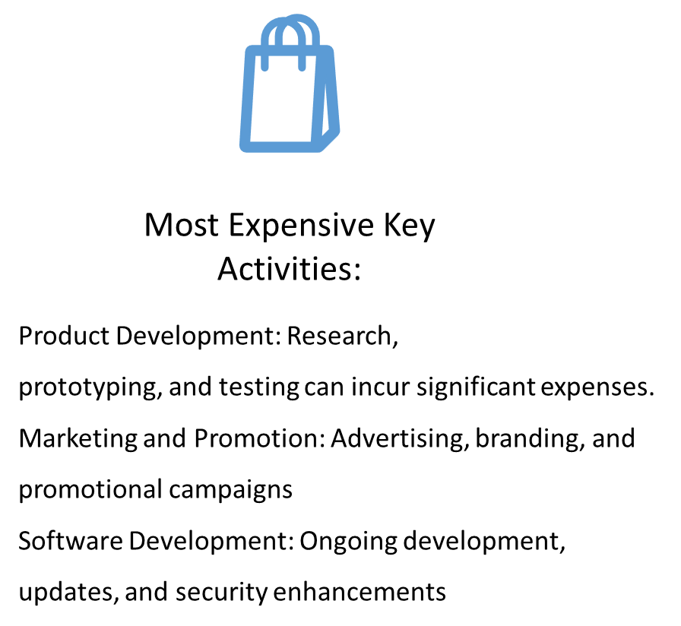

Cost structure
Most Expensive Key resources:
GPS Receivers
LORA Network infrastructure
Thermal Skin Contact Sensors
Encryption mechanisms
Manufacturing costs
Software Development

Slide 20
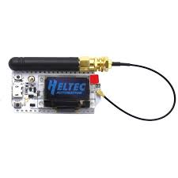
Technical solutions implemented: the LoRa communication protocol
Objective: Establish decentralized communication between two LoRa32 V3 Heltec modules using a private LoRa mesh network
Communication Parameters:
Frequency: 868 MHz (Europe).
Power: 20 dBm.
Data rate: 10 kbps.
Configure modules as network nodes.
Testing and Validation:
Verify range: 1 km (urban), 5 km (rural).
Assess communication reliability.

Slide 21
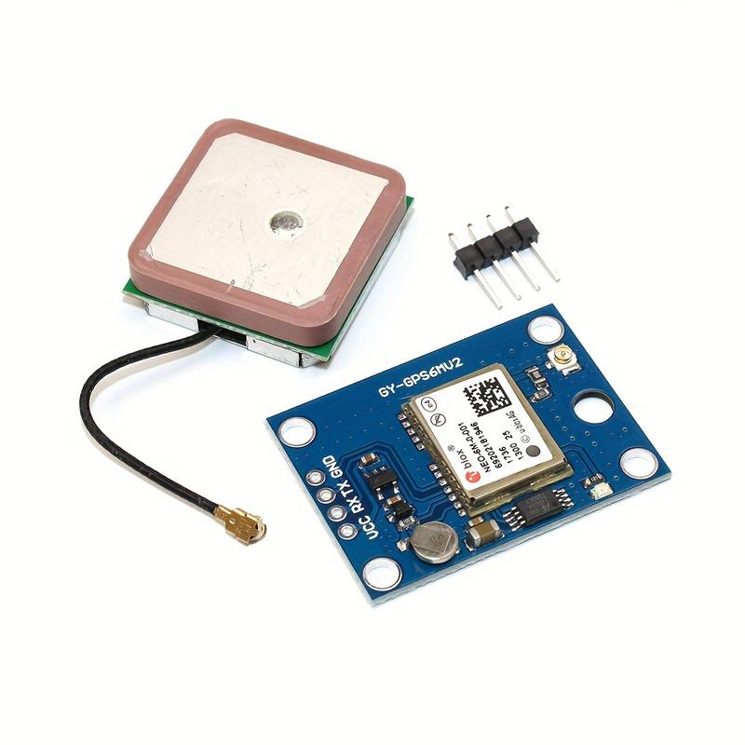
Technical solutions implemented: GPS sensor
Receiver Sensitivity: -162dBm tracking, -148dBm acquisition
Power Consumption: 50mA at 3.3V
Communication Interface: UART, default baud rate of 9600 bps
Backup Battery: Rechargeable 3.3V lithium-ion battery, 110mAh
Satellite Systems Support: GPS, GLONASS, Galileo
Frequency: L1, 1575.42 MHz
Accuracy: Position accuracy of 2.5m CEP, Velocity accuracy of 0.1m/s
Operating Voltage: 2.7V to 3.6V
Operating Temperature: -40°C to +85°C

Slide 22
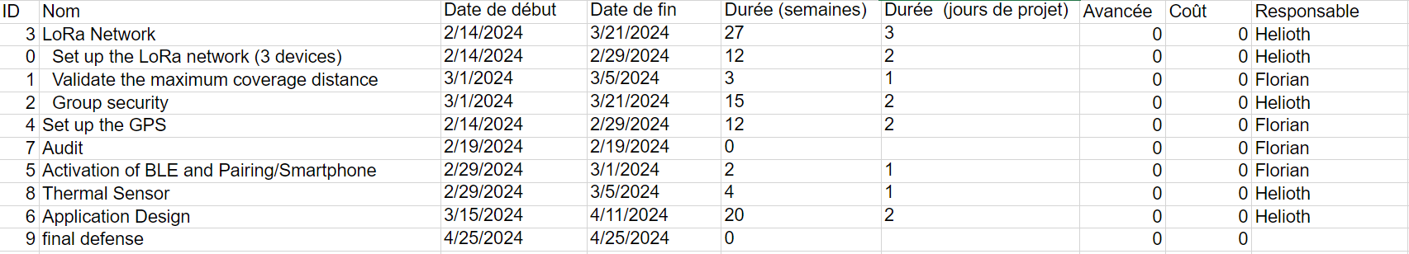
Task allocation

Slide 23
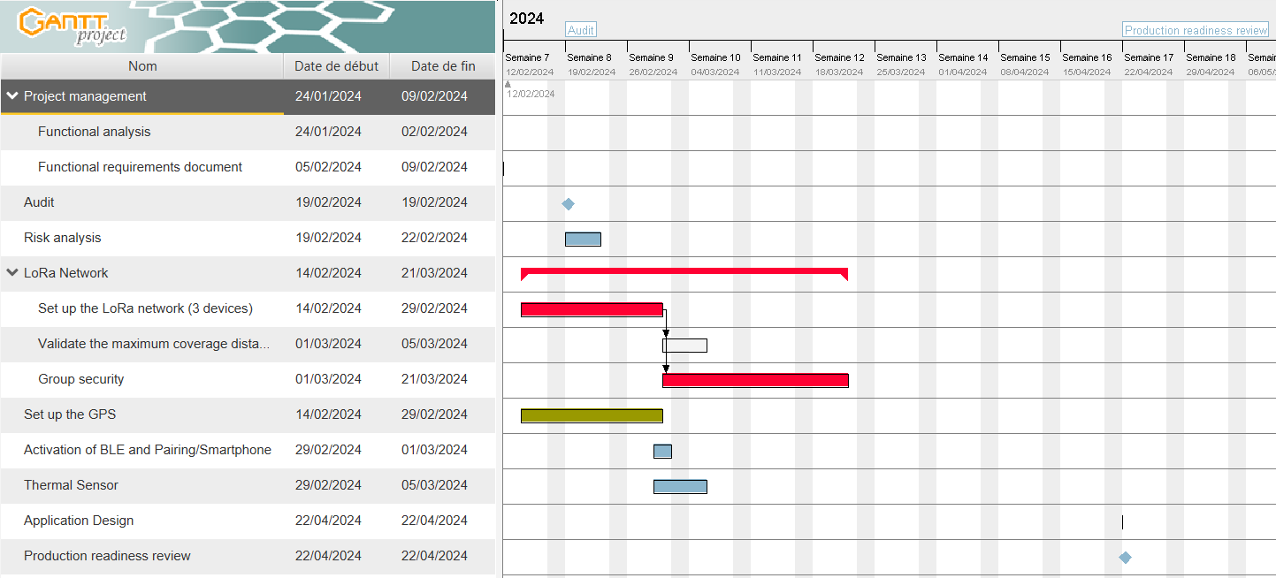
Planning

Slide 24
Conclusion
Validate the capability of establishing a private LoRa mesh network (deploying 3 devices) and verify the achievable distances
Integrate GPS, 1 or 2 buttons, and 1 or 2 LEDs.
Include BLE to transmit information to a smartphone (ensure proper reception of GPS, button, battery, zone limit/RSSI).
Develop the smartphone application (map, alerts, etc.).
Consider and promptly implement the pairing function, if necessary, complexity arises

Slide 25
Thank you for your attention

